Slide 1
Brain dump
Billing

Slide 2
Key Roles
Relationship manager/management – RM
Customers
RBS – Revenue and Billing system
KYC
Deal Manager (NEW)
DOS – Deal Onboarding System (Lombardi)
TMG – Transaction Management Group (Negotiators)

Slide 3
Key Systems
CT Systems
Deal Manager (new)
DOS – Deal Onboarding System n(Lombardi)
Enterprise – Engage (SFDC)
Enterprise (RBS)
FiRRe (used by CT)
Invoices
Collections
Account Set up
Fee Set up
Collections
Booking
Advantage (used by Asset Servicing)
Accounts
GL
Receipts
AR
CAP – Customer Activity Profile (Used by Treasury)
CPR – Customer Payments and Receivables
CSC – Customer Service Charge
EBW (PEGA)
Alteryx

Slide 4
e-CIF is the bank’s Customer Information File containing all information about clients and their accounts held as well as correspondents.
fIS is the vendor who acquired SunGard a few years ago. SunGard was the original owner of the FiRRe software used by RBS for Corporate Trust Billing.
RDH ??
BAC – Business Acceptance Committee. This group accept the deals from DM
DSC – Debt Service Engine

Slide 6
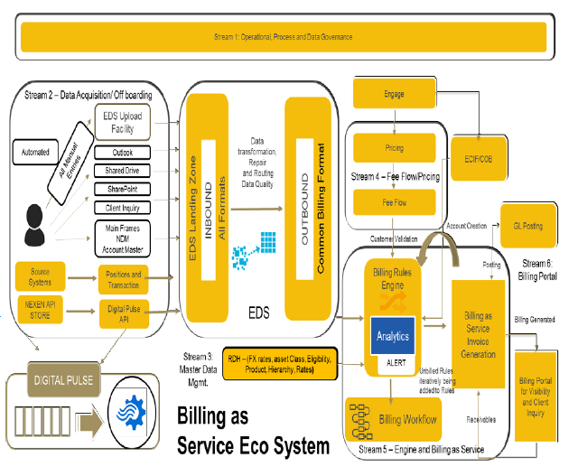
Enterprise – To be architecture

Slide 7
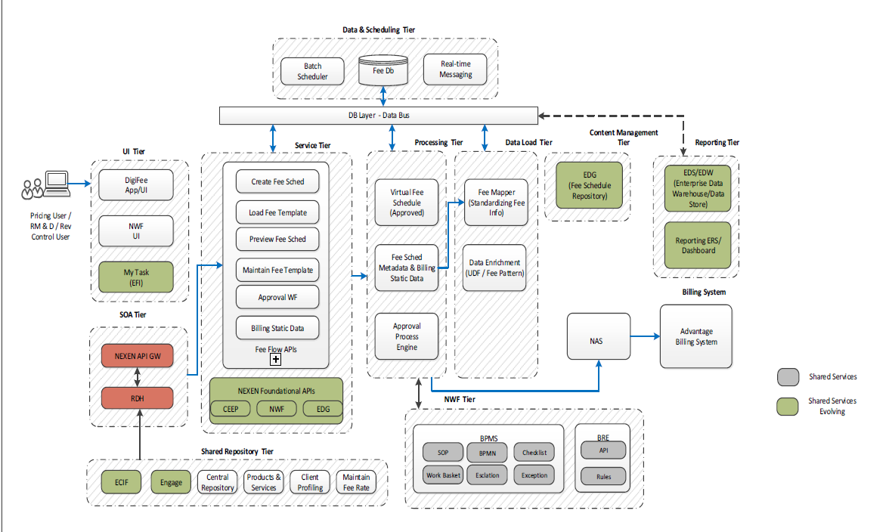
Fee Flow Target state

Slide 8
Ph1 and ph2 to build links between CT DOS (Lombardi) was completed in 2017 to push data to corporate billing systems. This will be revisited with new Deal manager system and FeeFLow systems to STP type processing.
Not sure if there is an expectation to have a “black box” that could intelligently move data back and forth between LOB systems and Enterprise billing systems. This data will be all the data required for account set up, billing data, invoice data, etc.. This needs to be two way as there will be several iterations
FEEFLOW (RBS)
Develop/Expose APIs for
Account set up
Callback for confirmation
Exception handling
etc
DEAL MANAGER (CT)
Consume the APIs and provide data back and forth with FEEFLOW
CT Data Mart
Store all data from all CT source systems amd RBS systems to store billing data, transaction data, enquiries, payment status, billing status, exception , receivables etc
Provide ability for CT business to slice and dice data w/o waiting for source systems/RBS systems
CT eBilling Portal
Enable a CT Billing portal which will be one portal to collaborate with RMs, customers., Integrate with Payment systems (?), get or generate invoices from RBS FiRRe, deliver to RMs, customers, track delivery of generation, billing, payment
??
DOS ?

Slide 9
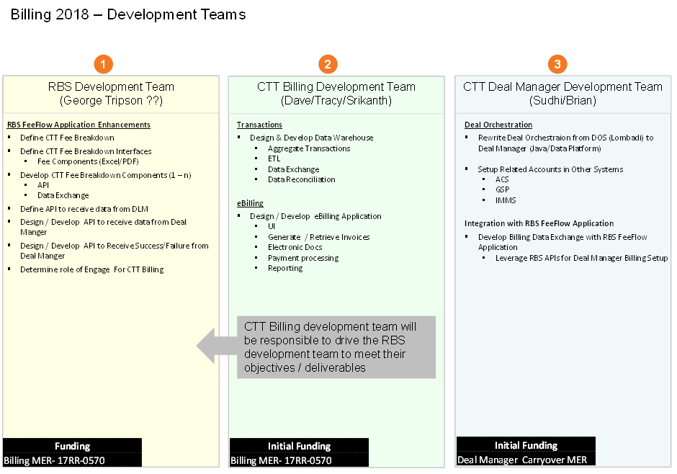

Slide 10
Notes from discussions with TB 1/23/18
There are 3 billing systems in BNYM – Treasury uses CAP, Asset Servicing uses – Advantage and CT uses FiRRe
3 major work streams affect CT
WS 1 - Internal Control over Financial Reporting (ICFR)
WS 2 – Global rollout of Deal Onboarding Solutions (DOS)
WS 3 - Fee Schedule Automation & Integration to Deal On Boarding
WS 4 - Automation of Transaction Capture Activities
WS 5 – E- Billing
WS 6 – ACH Processing
WS 7 – Revenue Leakage Automation Program
WS 8 - Government Billing Remediation
WS 9 – Global CT Billing Process Standardization
WS 10 – Migration to FiRRe (i.e. Milan)
WS 11 – Training
WS 12 – Collections
WS3
A Bi directional pipe to be build between DOS/DM to FeeFlow (FF) and also some integration to kick off the workflow on the PEGA (EBW) to create a work item. This integration would push deal data in a structured format from DM/DOS to FF to Alteryx (ETL) to FiRRe. This bidirectional pipe is needed to send transaction data from CT systems to RBS (Revenue and billing systems) and also to manage acknowledgements/confirmations/exception handling etc. This could be like creating a bunch of API’s from FF that could be consumed by all CT apps and other LOBs to push data. This will be done only during the initial set up or change of the deal. CREATE, UPDATE, DELETE Fee schedules + confirmation/exception/error returns.
WS4
Today, customers/RM agrees to a pricing/service/schedule and that’s set up in FeeFLow and Firre. Example – A wire done by BNYM will be charged at $25 every time.
At the time of service delivery (wire transfer happens) an entry is made in the system called CT DSC Debt Service Engine. A user keeps track of all wire transactions in an XL daily and an monthly updated file is uploaded to EBW. Billing team take this file and upload into FIrrE after some data massage in Alteryx. Automating this flow using a data pipe to move data from CT systems like DSC/Doc Custody/Loans to FiRRe automatically and remove all manual data entry/upload/UDTs.
WS5 – This will be eBilling portal to deliver invoices, details of the transactions contained in the invoices, expose invoice data available as Apis’ that client systems can consume. Possible status enquiry, tracking payments, tracking invoices, AR reports etc.. Collaboration ?
Asset Servicing (AS) already created integration with FF in H2 2017 and working in prod. This may still be AS specific integration
We may need to understand the integration mechanism and leverage for CT – FF integration

Slide 11
WS3 - Fee Schedule Automation & Integration to Deal On Boarding
CT Systems
AS Systems
Other LOBs
FF APIS to expose fee schedule set of APIS for each Lobs with variants of data elements needed for each LOBs
Create/Update/Delete APIs with optional and mandatory data elements needed to create a fee schedule and send the relevant data to FiRRE
Other systems like Alteryx, EBW
Unique Key to update LOB system on the confirmation from FF
Acknowledgement, status, errors back to consumer system
Fee
Flow
FiRRe
Workflow
Schedule approve/reject
RBS

Slide 12
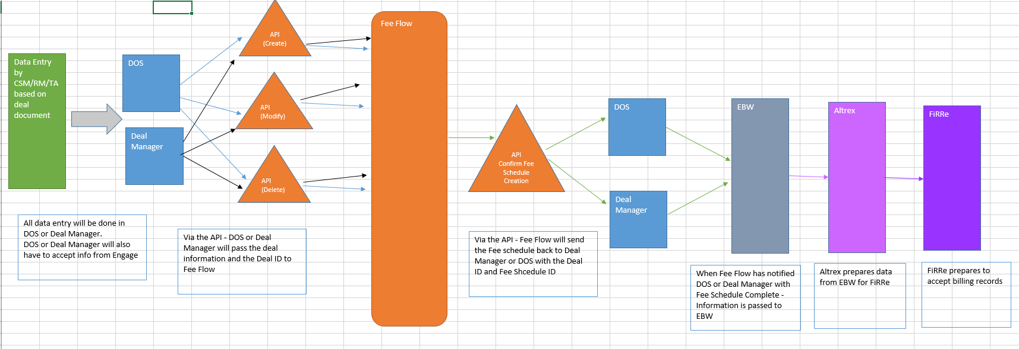
WS3 - Fee Schedule Automation & Integration to Deal On Boarding

Slide 13
WS4 - Automation of Transaction Capture Activities
Backend forth data extraction/XL UDTs
DSC
Doc Custody
IPA
Other systems
FiRRe
CT User
Multiple formats/data integration. Lots of manual efforts/system to system hops- AUDIT findings
Planned – not there today
RBS (FF, EBW, Alteryx, FiRRe)
DSC
Doc Custody
IPA
Other systems
CT Data Platform
Multiple formats/data integration. Lots of manual efforts/system to system hops- AUDIT findings
3rd party system consuming data from our platform directly into their systems
Master data
CT user slice/dice
Reporting
Exposing to customers via eBilling (WS5)
3rd Party Customer systems
CT User

Slide 14
WS 5 – E- Billing
CT Data Platform with all billing data
eBilling Portal
RM, customers

Slide 15
Work stream | BA | Tech Lead | Data Analyst
WS3 - Fee Schedule Automation & Integration to Deal On Boarding |  | Walter White
WS4 - Automation of Transaction Capture Activities
WS 5 – E- Billing

Slide 16
DM
RBS
Fee Schedule Set up
FF
Other CT Systems
CT Billing Platform
EBW
Alteryx
DSC
FiRRe
Billing Transaction
Other CT Systems
eBilling Portal
RM, customers

Slide 17
S.No | Activity | Outcome | Use
#1 | Data mapping between DM-FF-FIRRE | What data needs to be capture in DM from UI which is not captured today What data is required by Firre to generate invoices and its source | DM UI changes Input to Billing platform Data model
#2 | FF FRD | FRD to contain 2 parts Data elements needed to create a fee scheudle. What APIs. Happy, exception, acknowledgements etc DM will need to include data elements that it can push consuming these APis. | Ability to create integration design between DM – FF Assess a possibility of CT Billing Data platform as a consolidation engine (??)
#3 | Source system analysis for billing transaction | CT Billing data platform logical design
#4 | Initiate Prototype phase | Capturing the client needs/wishes as part of our UX design/wireframes for eBilling | Be able to plan eBilling sprints, feature development activities Be able to prioritize the PDF invoice delivery process (Email or portal)
#5 | Review current FF APIs’ and also their strategic plans to integrate with other billing systems (EBW-Alteryx-Firre) | View into designing exceptions/understanding data hops | simulate failure conditions etc for tests/validations Test cases, To understand Data transformations done on the way to Firre
#6 | Architecture of CT Billing platform | How CT systems would integrate with Revenue and Billing system (RBS) What level of data to be stored in the CT Billing Data platform (from Feee schedule/Billing transaction data) Define archietcture guidelines/data owners/data security (if any)

Slide 18
Other stuff

Slide 19
Big Picture
Workflow in Pega used to initiate workflow to track activities. Gauge the inflow of deals
Current – lots of XL based data movement and manual efforts to key in data
Customers, Prospects, RMs
RBS Systems
EBW (Pega) Manual key in
Alteryx
Firre – Manual key in
Use Engage (SFDC)
Work on Prospective deals
FeeFlow (NEW)
Proactive data set up for some deals before its finalized
Deal approved by centralized team
Deal data set up in Deal Manager (new) or DOS (Legacy Lombardi)
Billing module A (NEW)
Finalized Deal

